Slide 1
Docker Introduction

Slide 2
What is Docker?
Docker is a tool that makes it easy to build, manage and run containers.
Containers provide a way to run something in isolation from a system (physical system or VM) that it is running on.
Docker provides a common distribution method for pre-built solutions.
Docker provides a lightweight, fast and portable runtime that allows a container to run anywhere*.

Slide 3
What Docker is NOT
Docker is not a replacement for VMs
Docker does not orchestrate across multiple systems
It only focuses in on running containers on a single system
Docker is not truly secure isolation for workloads
Strong security is in place but may not be appropriate for hard multitenancy
Security can be tightened but kernel is always shared

Slide 4
Docker Components
Image:
A read only copy of what you want to run
Container:
A runnable copy of an image on your system
Network:
Private or public networks for containers to attach to
Volumes:
A place for containers to put data that lives outside their container

Slide 5
How does it work?
Virtual Machine
Docker images only contain the application, supporting binaries and libraries.
Docker containers are hosted by the docker engine on an existing system.
All docker containers share the kernel of the system that they are running on
Docker containers operate in their own separate namespace to isolate them from the system

Slide 6
How does it work?
Docker images are built and placed in a common docker registry
Registries can either be private or public
Docker client will run a docker container
This will pull down a docker image from the registry and run it

Slide 7
Docker Images
Exist in a remote registry
Are referred to by a name and a tag
I.E. dockerhub.com/consul:1.0
Location Name Tag
Consist of multiple layers based on how they are built
Layers can be re-used across containers and are only pulled if not present

Slide 8
Docker Container Isolation
Docker containers run isolated from the system using kernel namespaces
Cannot see processes outside its container
Cannot see files outside its container unless provided access
Each container receives its own dedicated network stack
All files written will be a copy-on-write to keep the image in tact
CGroups can provide resource isolation to limit the resources that a container consumes

Slide 9
Why Docker?
Portable way to package and distribute an application and its entire runtime together.
Services rarely runs by themselves and require tons of supporting libraries and binaries.
Can create and delete docker containers without compromising the system they are running on.
Docker ecosystem is very strong and integrates with orchestration systems, security systems and CI/CD processes very well.

Slide 10

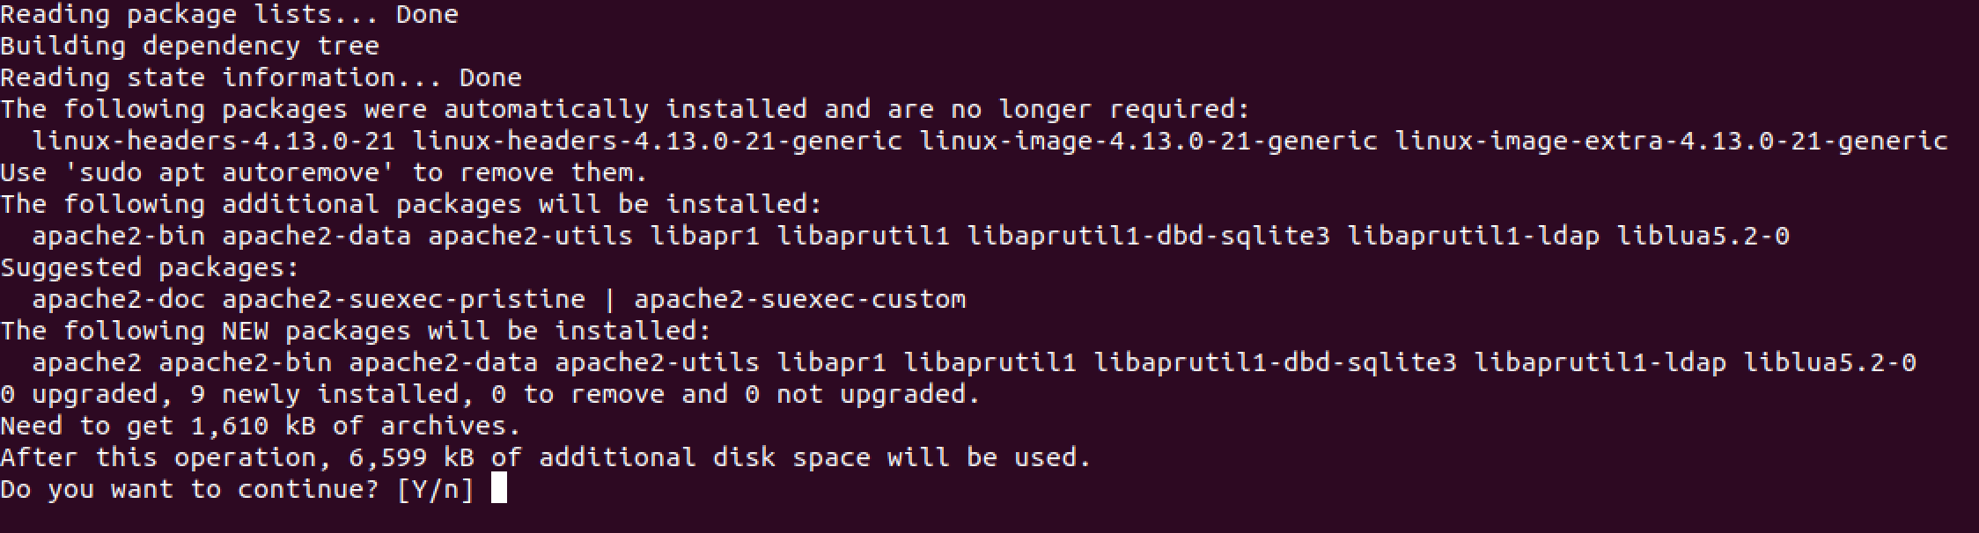
So you want to install an application in Apache?
Oh… I didn’t ask for all of this…

Slide 11
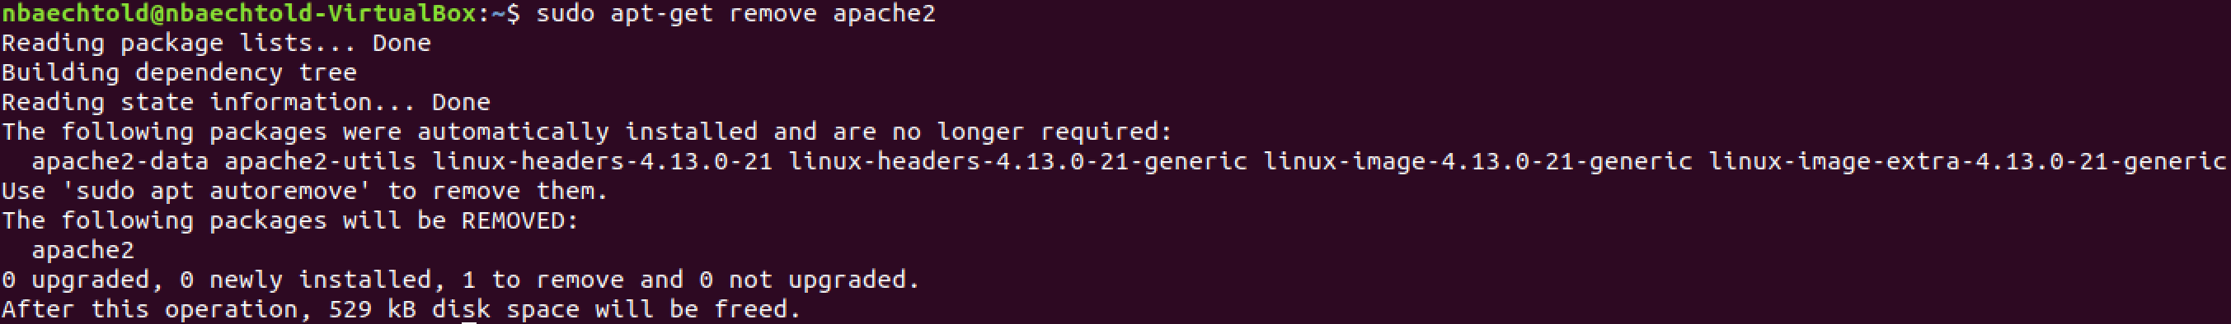
So you want to remove Apache?
Wait… what about the other 6 MB of packages?
Will my system be the same as it was before I installed apache?
Spoiler… It will not!

Slide 12
Working With Docker

Slide 13
Building Docker Images
Docker images are build using a DockerFile
Can be then be pushed to a registry or run locally
Built using the “Docker Build .” command

Slide 14
Running Docker Containers
Containers are run with the docker run command
Docker containers are customized with environment variables and volumes
Host filesystem can be exposed to the container though docker volumes
Host ports can be mapped to containers
Networking can either be a private network or share the host’s network
Container can be started as a daemon

Slide 15
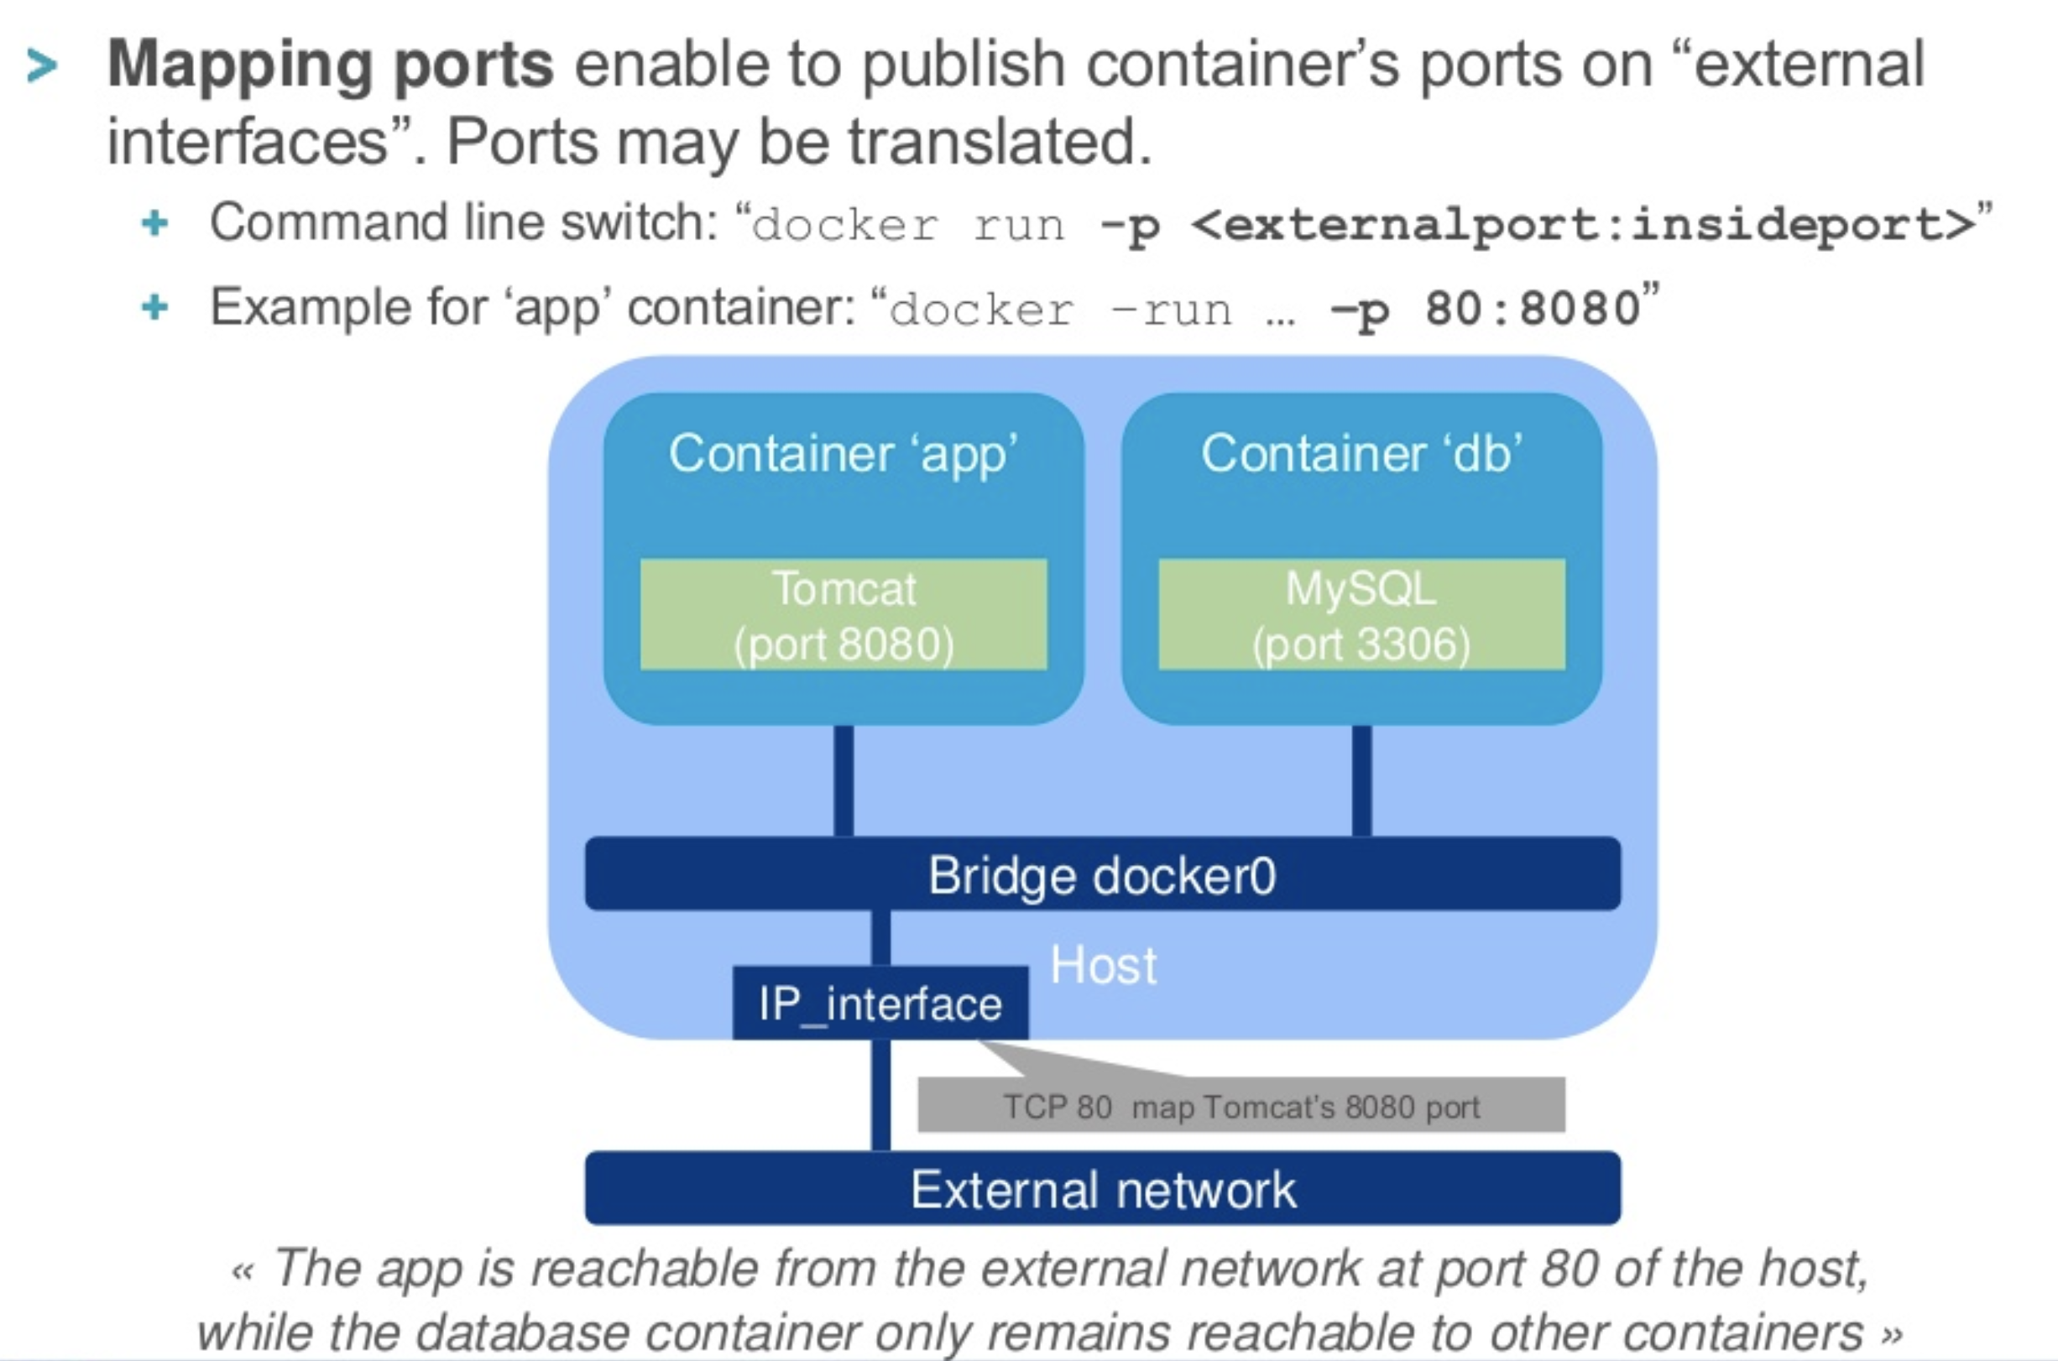
Port Mapping

Slide 16
Demo…

